Slide 1
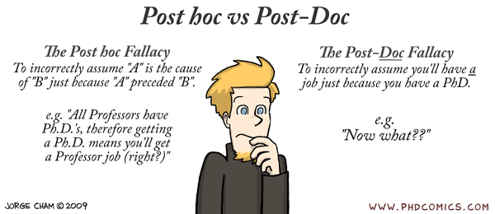
Post hoc tests; Kruskal Wallis
Geog4300/6300
Jerry Shannon

Slide 2

Study: Two new drugs to treat anxiety: anxifree and joyzepam. Do either (or both) have a beneficial effect?

Slide 3
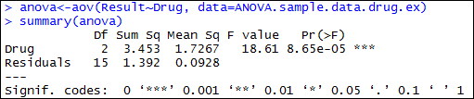
You’ve run an ANOVA analysis that’s come out significant.
NOW WHAT?
Participant | Drug | Therapy | Result
1 | placebo | no.therapy | 0.5
2 | placebo | no.therapy | 0.3
3 | placebo | no.therapy | 0.1
4 | anxifree | no.therapy | 0.6
5 | anxifree | no.therapy | 0.4
6 | anxifree | no.therapy | 0.2
7 | joyzepam | no.therapy | 1.4
8 | joyzepam | no.therapy | 1.7
9 | joyzepam | no.therapy | 1.3
10 | placebo | CBT | 0.6
11 | placebo | CBT | 0.9
12 | placebo | CBT | 0.3
13 | anxifree | CBT | 1.1
14 | anxifree | CBT | 0.8
15 | anxifree | CBT | 1.2
16 | joyzepam | CBT | 1.8
17 | joyzepam | CBT | 1.3
18 | joyzepam | CBT | 1.4

Slide 4
What are the possibilities?
H₀ = All three drugs have equal effects
H_{A} = The drugs have unequal effects
J = A | J = P | A = P | Hypothesis
X | X | X | Null
X |  |  | Alternate
 | X |  | Alternate
 |  | X | Alternate
X | X |  | Alternate
X |  | X | Alternate
 | X | X | Alternate

Slide 5
How do we know which is correct?
Post-hoc tests can check for this
J = A | J = P | A = P | Hypothesis
X | X | X | Null
X |  |  | Alternate
 | X |  | Alternate
 |  | X | Alternate
X | X |  | Alternate
X |  | X | Alternate
 | X | X | Alternate

Slide 6
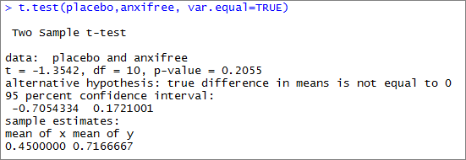
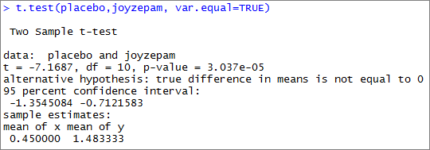
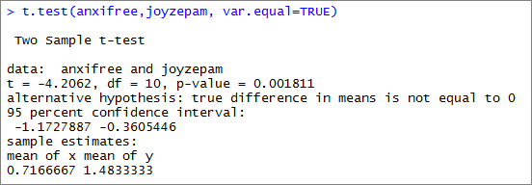
We can run two sample tests on the data

Slide 7
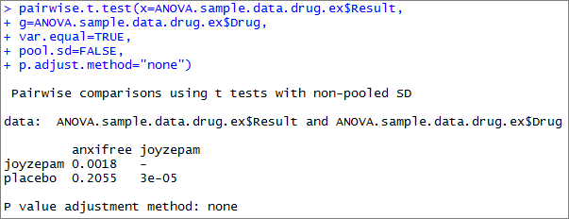
pairwise.t.test does this for all variables

Slide 8
How many different combinations?
n!
x!(n-x)!
3!
2!(3-2)!
=
= 3
What if we had eight groups?
n!
x!(n-x)!
8!
2!(8-2)!
=
= 28
To control for potential false positives, post hoc tests use statistical corrections.

Slide 9
Bonferroni correction:
Multiply the number of tests (m)
by the p-value for each test
For three tests:
3 * 0.0018 = 0.0054
3 * 0.2055 = 0.6165
3 * 0.00003 = 0.00009

Slide 10
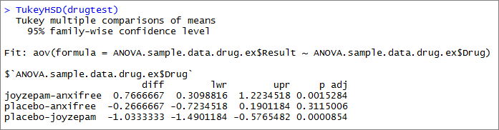
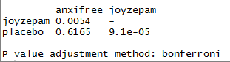
Many people use the Tukey HSD test as a correction. It also adjusts for repeated trials.
Compare with Bonferroni:

Slide 11

In ANOVA and many other tests, it’s important to check our assumptions!

Slide 12
ANOVA makes two assumptions:
The residuals from the ANOVA are normally distributed.
Variance is equal in each of your groups.

Slide 13

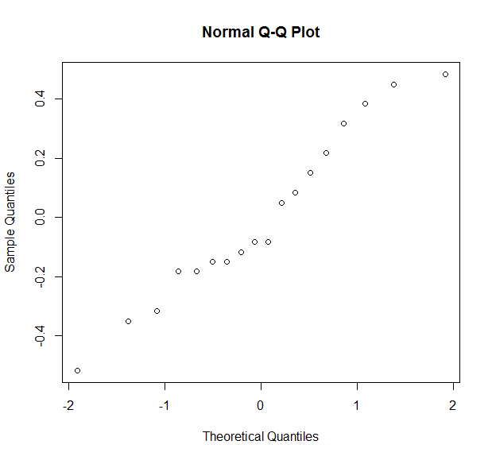
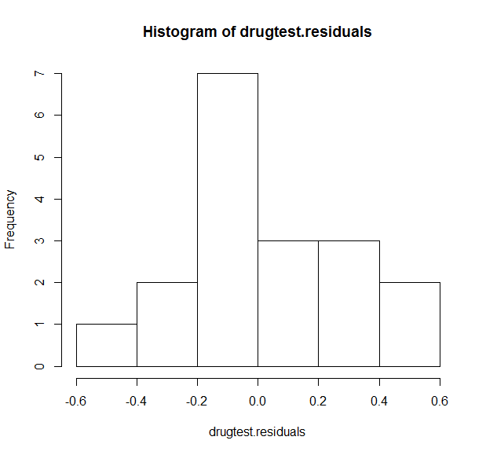
We’ll talk more about residuals with regression. It’s a form of model error.
You can check their normality using R:

Slide 14
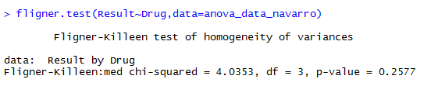
There are several tests for equal variance between groups. The easiest in R is the Fligner-Kileen test.
Remember: H₀ = Variance IS equal.

Slide 15

The Kruskal-Wallis test is a non-parametric version of ANOVA.
Like the Wilcoxon tests, it relies on ordinal rankings of data.
In R, it’s the function “kruskal.test”

Slide 16
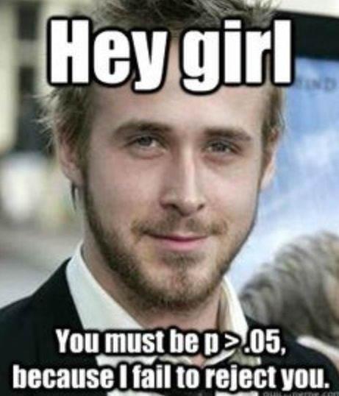
Let’s try it out!

